Slide 1
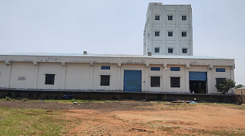
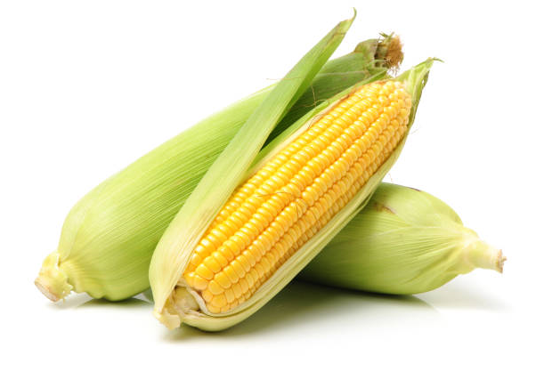

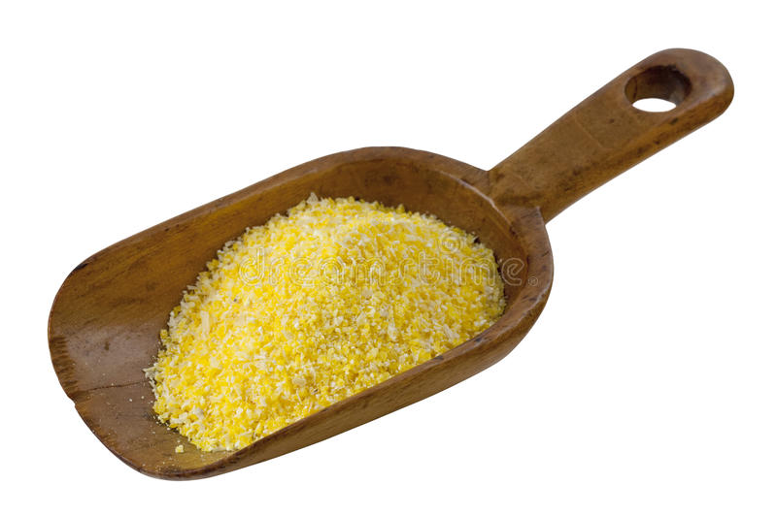
SUPRIYA CORN PRODUCTS PVT LTD

Slide 2
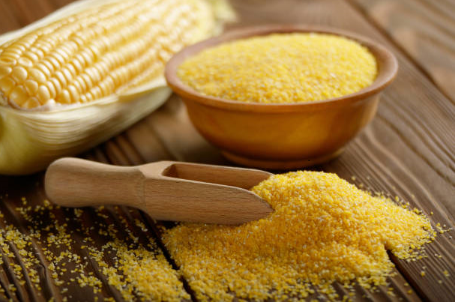
SUPRIYA CORN PRODUCTS PVT LTD - A 20-year-old company that trades Corn, Maize, Spices, Grains and Pulses. Our main goal has been to source products directly from farmers, market yards, and government organisations like FCI and NAFED at the most affordable costs via our network. We believe in good and ethical business makes a win-win situation and helps in expansion of business beyond countries boundaries. We gained consistent reputation from our customers all around the world for the supply of high quality food products. Now we came out with new factory with best production equipment and latest technologies to manufacture top-quality Corn and Maize products. Our Products : 1. Corn Grits/ Fines/ Flakes/ Flour/ Meal. 2. Maize Grits/ Fines/ Flakes/ Flour/ Meal. We are located at Sy No.828/A, Chegur (V) Nandigama (M), RR Dist. Hyderabad, Telangana – India which spread over 3 acres of Land.

Slide 3
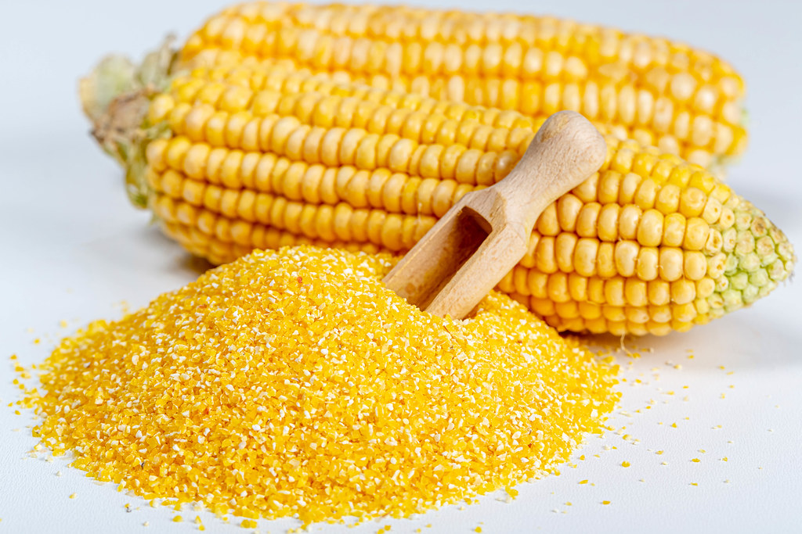
Corn contains a large amount of lecithin, linoleic acid, grain alcohol, vitamin E, cellulose, etc., which has a variety of health effects such as lowering blood pressure, lowering blood lipids, anti-arteriosclerosis, preventing intestinal cancer, beautifying skin, and delaying aging. It is also good for diabetic people.

Slide 4
Our total equipment was supplied by M/s Buhler AG (Switzerland ) & Installed by M/s Buhler India (Bangalore) ensuring highest Sortex quality of Finished Product and very highly trained workforce who ensure our quality is the best in manufacturing industry with the Production capacity of 120MT / Day, unit of plant for manufacturing of our products Our food products are the best because we ensure the products does not loose its nutrients while we are processing. We wish to manufacture as per the customer specified size/ grade starting smaller to larger product particle. We carry out processing in a hygienic, controlled and safe manner and we organise continuous quality check starting from purchase of raw material to finished product. Our prices are low because we want many people to consume a product that is of nutritional value.

Slide 6
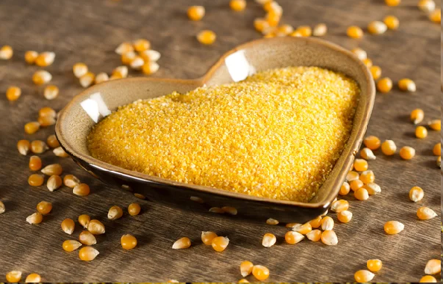
CORN / MAIZE GRITS COARSE- FINE PRODUCT TYPE- 101/101A/108 SORTEX
PROPERTIES | TYPICAL VALUE | RANGE
MOISTURE | 12.20% | 11.5 -13.5%
FAT | 0.80 % | 0.5 – 2.0 %
TOTAL ASH | 0.35% | 0.2 -0.5 %
PROTEIN | 7.80% | 7.0 – 9.0 %
ALCOHOLIC ACIDITY | 0.09% | 0 - 0.15 %
DENSITY | 0.67 | 0.6- 0.7 %
STARCH CONTENT | 53.6 | 50 – 60 %
CRUDE FIBER | 0.3 | 0.2 -0.4 %
BLACK SPECS | 3 | 0-12/ 10 SQ INCH
PARTICLE SIZE | TYPICAL VALUE ** | RANGE
ON 1000 MICRON | 50% | 48 -52%
ON 710 MICRON | 45.2% | 42- 46%
ON 425 MICRON | 4.5% | 3.5 – 5.5%
ON 300 MICRON | 0.3% | 0 -0.5%
PAN | 0 | 0
Corn/Maize Grits are medium in size and nutritious and Indian non- GMO. It is processed and refined as per the size specified by the customer with our automated roller mills.
These are used primarily in extruded snack food industry, breakfast cereals, breweries, confectionery and baking applications etc
For Maize grits we don’t use any additives and preservatives
Packaging:
20kg, 25 kg, 50 kg PP bag or paper bag
500 kg, 1000 kg Jumbo bag as per buyers requirement
Any particle size orders can be processed as per customer requirement and MOQ

Slide 7
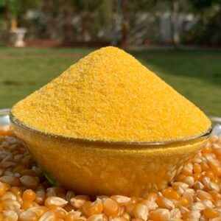
CORN / MAIZE GRITS – SUPER EXTRA FINE PRODUCT TYPE- 109/110 SORTEX
PROPERTIES | TYPICAL VALUE | RANGE
MOISTURE | 12.45% | 11.5 -13.5%
FAT | 0.92 % | 0.5 – 2.0 %
TOTAL ASH | 0.35% | 0.2 -0.5 %
PROTEIN | 7.58% | 7.0 – 9.0 %
ALCOHOLIC ACIDITY | 0.09% | 0 - 0.15 %
DENSITY | 0.72 | 0.65- 0.75 %
STARCH CONTENT | 58.6 | 50 – 60 %
CRUDE FIBER | 0.3 | 0.2 -0.4 %
BLACK SPECS | 5 | 0-12/10 SQ INCH
PARTICLE SIZE | TYPICAL VALUE ** | RANGE
ON 600 MICRON | - | 0%
ON 425 MICRON | 58 % | 50 -65 %
ON 300 MICRON | 30 % | 25 -35 %
ON 250 MICRON | 10 % | 10 -12 %
PAN | 0 | 0
Corn/Maize Grits are fine in size and nutritious and Indian non- GMO. It is processed and refined as per the size specified by the customer with our automated roller mills.
Fine Corn / Maize grits are used in from Snack Extrusion, ready-to-eat Cereals, brewing adjuncts and pet foods. These products are also used in pizza and bakery applications
For Maize grits we don’t use any additives and preservatives
Packaging:
20kg, 25 kg, 50 kg PP bag or paper bag
500 kg, 1000 kg Jumbo bag as per
buyers requirement
Any particle size orders can be processed as per customer requirement and MOQ

Slide 8
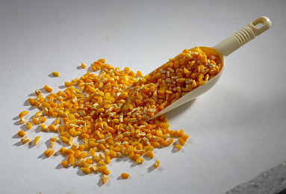
CORN/MAIZE FLAKING GRITS/ BREWERY GRITS PRODUCT TYPE SA#1/ SA#2/SA#3/SA#4
PROPERTIES | TYPICAL VALUE | RANGE
MOISTURE | 12.52% | 11.5 -13.5%
FAT | 0.98 % | 0.5 – 2.0 %
PROTEIN | 7.80% | 7.0 – 9.0 %
DISCOLOURED | 1 Pc/ Kg | 3 Pc/ Kg Max
DAMAGED | 2 Pc/ Kg | 5 Pc/ Kg Max
WHOLE KERNELS | 25 Pc/ Kg | 50 Pc/ Kg Max
COBS / STALK | 5 Pc/ Kg | 10 Pc/ Kg Max
FREE GERMS | 0 | 2 Pc/ Kg Max
SHELL ATTACHED | 22 Pc/ Kg | 40 Pc/ Kg Max
PARTICLE SIZE | TYPICAL VALUE ** | RANGE
ON 4750 MICRON | - | 0 – 2%
ON 4000 MICRON | 15.5 % | 10 – 20 %
ON 3350 MICRON | 73.7% | 30 – 85 %
ON 2800 MICRON | 10.8 % | 0 – 15 %
PAN | 0 | 0-1%
Flaking grit is the largest size grit produced for the food Industry.
It is nutritious and Indian non – GMO
Grit size and purity are at a premium.
We will manufacture the product as per the customer requirement.
For Maize flaking grit we don’t use any additives and preservatives
Packaging:
20kg, 25 kg, 50 kg PP bag or paper bag
500 kg, 1000 kg Jumbo bag as per buyers requirement
Any particle size orders can be processed as per customer requirement and MOQ

Slide 9
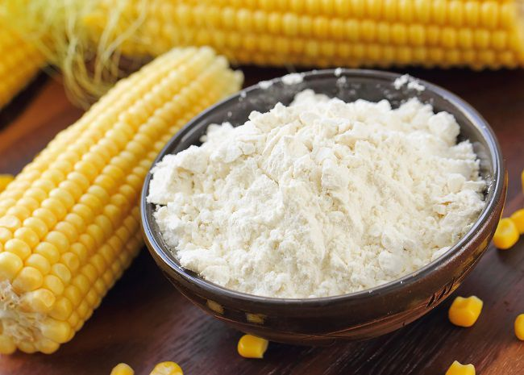
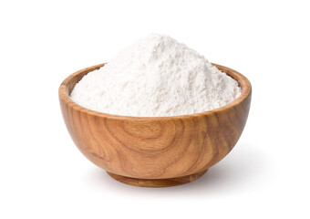
CORN/MAIZE FLOUR
PROPERTIES | TYPICAL VALUE | RANGE
MOISTURE | 12.35% | 11.5 -13.5%
FAT | 0.72 % | 0.5 – 2.0 %
TOTAL ASH | 0.95% | 0. – 3 %
PROTEIN | 7.58% | 7.0 – 9.0 %
STARCH CONTENT | 68.6 % | 60 – 70%
CRUDE FIBER | 0.3 | 0.2 – 0.4 %
PARTICLE SIZE | TYPICAL VALUE ** | RANGE
ON 425 MICRON | - | 0 %
ON 250 MICRON | 4.2 % | 0 -0.5 %
PAN | 95.8 % | 90 – 96%
Corn Flour is a fine granular product that is used as filler, binder and thickener in the cookie, pasty and meat industries. It is nutritious and Indian non – GMO
This product is used as main ingredient for pan cake mixes, breads, muffins, ready to eat cereals and other bakery mixes. . Corn flour biscuits and halwa (pudding) are some of the sweet dishes made from corn flour.
Packaging:
20kg, 25 kg, 50 kg PP bag or paper bag
500 kg, 1000 kg Jumbo bag as per buyers requirement
Any particle size orders can be processed as per customer requirement and MOQ

